Slide 1



SWCF‑B1 — Smart Water Control System (ielivate / Pammas)
Solar-powered • Leak detection • Automated schedules • Dashboards
SWCF‑B1 — Smart Water Control System (ielivate / Pammas) with AI
Solar-powered • Leak detection • Automated schedules • Dashboards
AI-powered Pest Control Solution
Developed by : pammas Group or innovation
Presented by: Mohammed Belhachemia

Slide 2
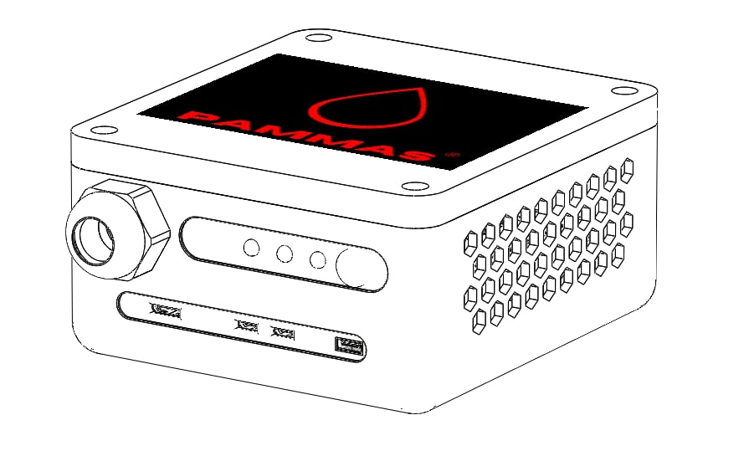

Project Overview
IELIVATE SWCF‑B1 introduces a sustainable smart irrigation & pest system powered by AI and solar.
Designed for off‑grid regions to reduce water waste up to 40% and improve yield & efficiency.
Combines IoT hardware, predictive analytics, and eco‑friendly automation for climate‑resilient farming.
Ref: project overview in pitch content.

Slide 3
Team
Core team
Responsibilities
Belhachemia Mohammed Ibrahim — Founder & Technical Project Lead (AI integration, prototyping, leadership).
LinkedIn: linkedin.com/in/ibrahim-mohammed-fr
Bouzidaoui Mohammed — 3D modeling & simulation.
LinkedIn:https://www.linkedin.com/in/bouzidaoui-m-979051129/
Project leadership from concept to prototype & go‑to‑market.
Integrate AI models into software & hardware for detection & prescription.
Design embedded edge devices and system architecture (smart traps, controllers).

Slide 4

Problem Statement
70%+ of freshwater used inefficiently across the region.
Climate change + outdated irrigation threaten food security.
Lack of AI‑powered irrigation and visibility causes resource loss.
Question: How can Algeria ensure the sustainability and productivity of its agriculture in the face of mounting water scarcity and systemic inefficiencies in irrigation management?
Water Wastage
Labor Intensity
Uneven Distribution
?

Slide 5

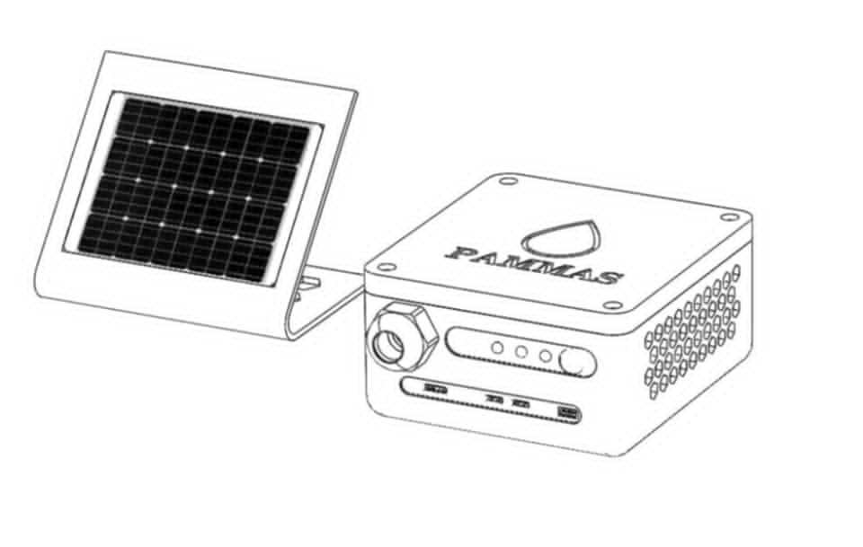
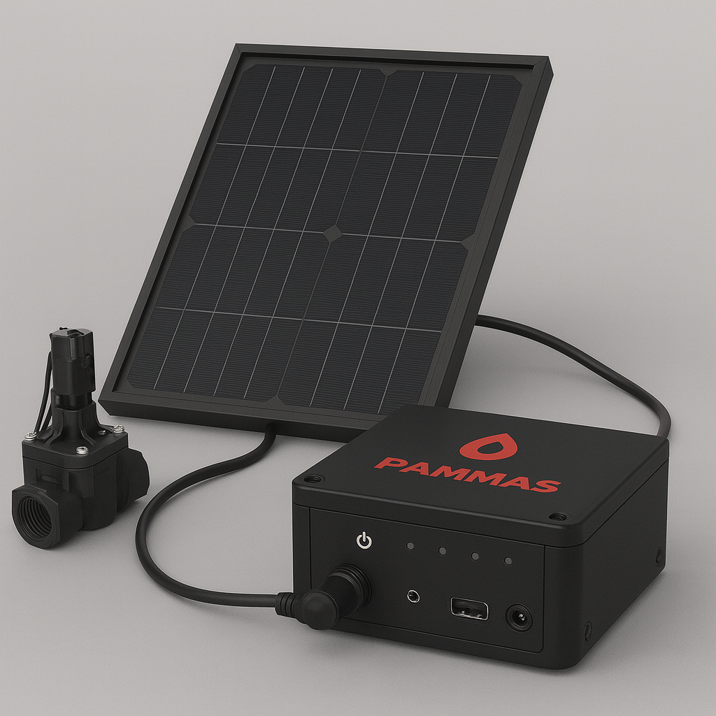
Our Solution (Smart Box)
Intelligent hub or Small smart Box that learns & adapts: uses real‑time soil, weather, crop data.
Autonomous water distribution & pest prevention; solar energy for remote continuity.
Mobile dashboard for insights and control.

Slide 6
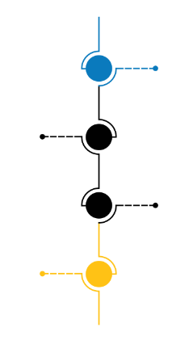
Intellectual Property & Legal Recognition
Impact pillars
Trademark Secured: Official mark not registered and recognized by INAPI but in the process.
Legal Assurance: Full compliance with national IP regulations to safeguard brand and technology (domain right)
Strategic Advantage: Strengthened credibility for investors, partners, and clients through formal recognition.
Growth Readiness: Protected foundation for scaling operations, product expansion, and international branding.

Slide 7
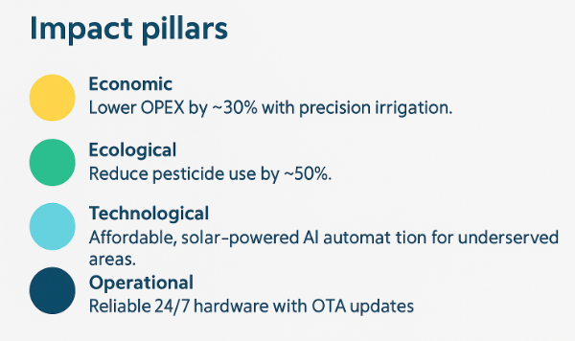
Core Value
Impact pillars
KPIs (site‑dependent)
Economic — lower OPEX by ~30% with precision irrigation.
Ecological — reduce pesticide use by ~50%.
Technological — affordable, solar‑powered AI automation for underserved areas.
Operational — reliable 24/7 hardware with OTA updates.
Water: −20–40%
Time: +6 h/week saved
Energy: −10–25%

Slide 8
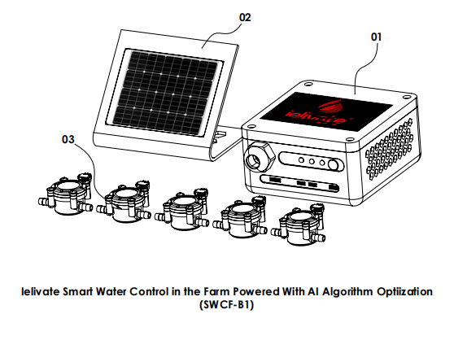
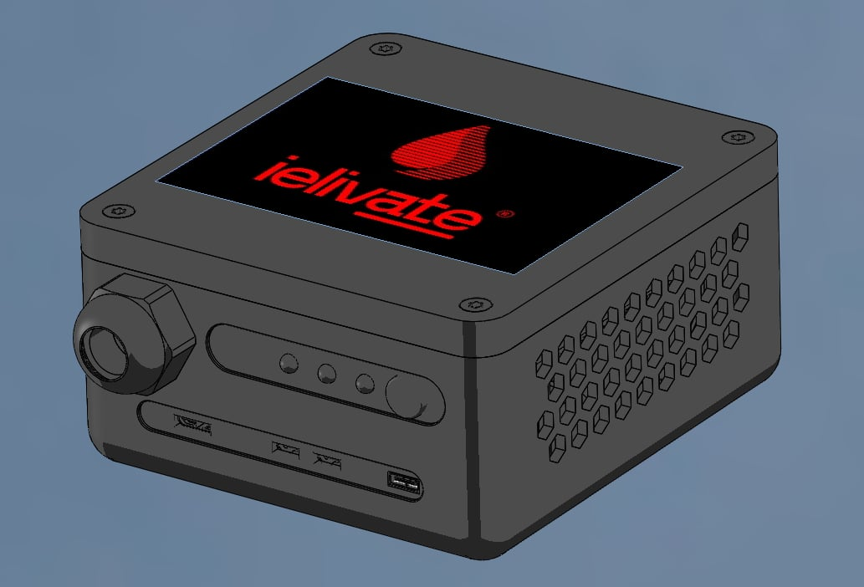
Prototype & Technology
Hardware
Software & connectivity
Pheromone dispenser (traps), camera module, panels & sensors.
12‑V solenoid valves & pump relays; flow & pressure sensors; soil/temp inputs.
Rugged enclosure; solar + battery.
AI insect ID (TensorFlow Lite).
Connectivity: Wi‑Fi, LoRaWAN, GSM/Cell.
Lightweight API for mobile/cloud; dashboards & logs.

Slide 9
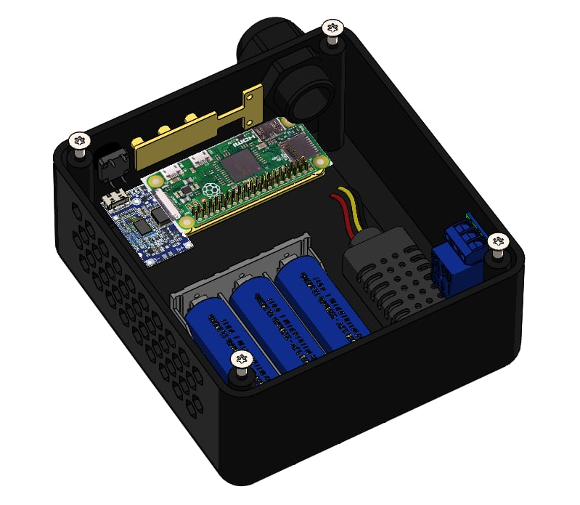
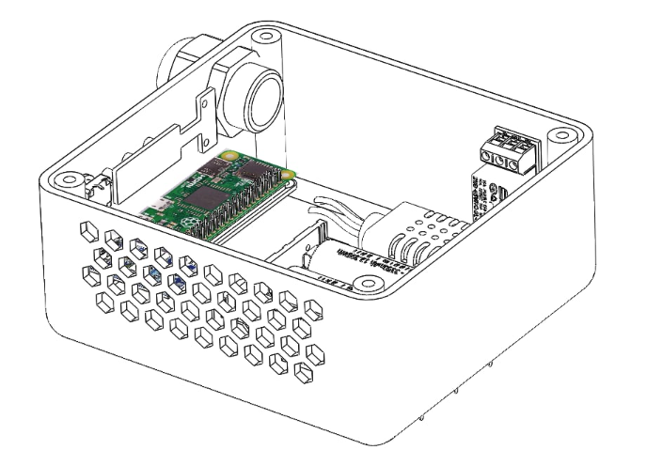
Prototype & Technology
Hardware
Solar-powered, weather-resistant control box that drives a 12 V irrigation solenoid, reads basic agronomic sensors, and exposes a lightweight device API (Flask) for mobile/Cloud control. Hardware scope in the reference guide explicitly covers “hardware wiring & power topology (12 V valve + sensors + Pi)
Colore version
-For the marketing
FULL BATTERY OPTIMIZATION ITHIEUME

Slide 10
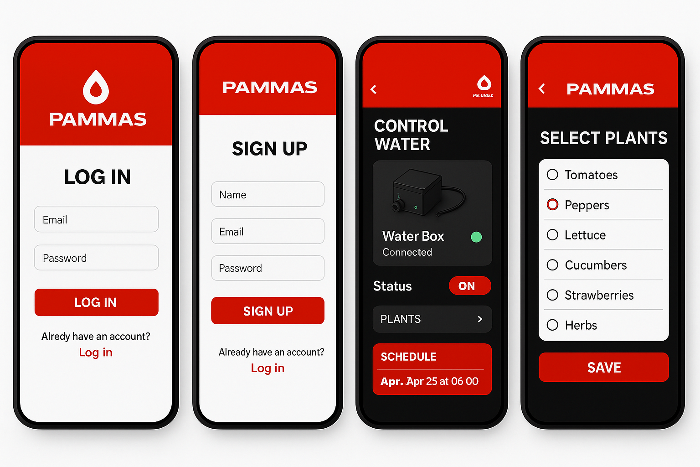


Prototype & Technology
Software & connectivity
The mobile app connects to the cloud through the internet to exchange and store data securely, while the Raspberry Pi acts as an intermediary edge device that uses its Wi-Fi connection to transmit or receive data from the same cloud platform or use Wifi like router setup.
+
+
Connection
Encrypted between deviceS
FULL MOBILE APP CONTROL THAT HELP ME MANAGE THE SAMRT WATER BOX

Slide 11
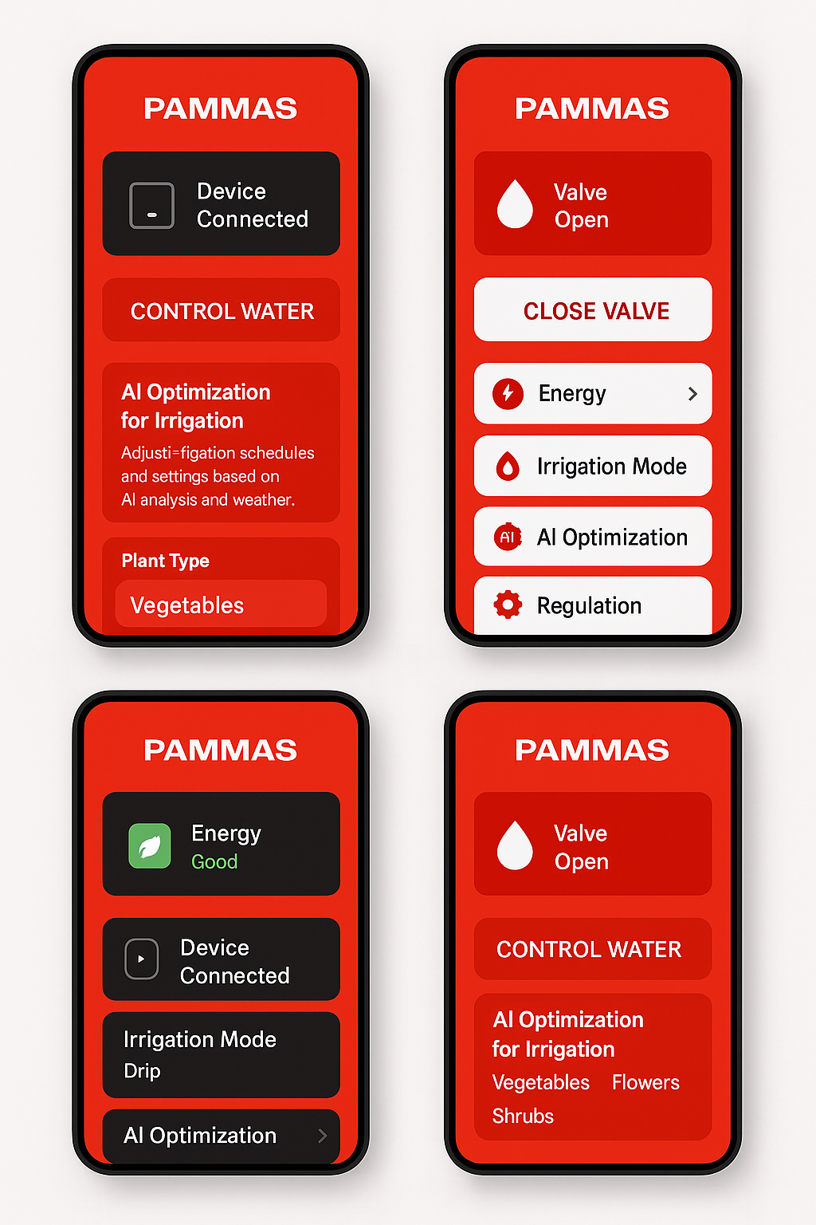
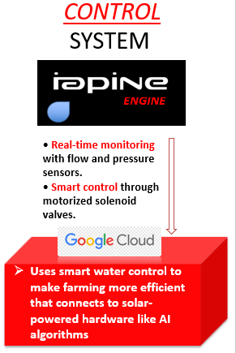

Prototype & Technology
Software & connectivity
RUN SCRIPTS
WITH MODE
AI SELECTION
FULL REMORE CONTROL
Send API
Send results
DECISON MAKING Based in the Equipement

Slide 12

VIDEO AND WEBSITE DEMO DEMENSTRATION
Youtube Channel demo :
Website Site link full report :
Business and Analytics full report

Slide 13

Business Model Canvas (summary)
Segments & Channels
Value & Revenue
Value: real‑time detection, solar, low‑maintenance, eco‑friendly.
Revenue: device sales + analytics subscription + partner/government programs.
Customer segments: smallholders, co‑ops, gov agencies, NGOs.
Channels: direct, expos, distributors, partnerships.
- Customer Segments: Smallholder farmers, agricultural cooperatives, government agencies
- Value Propositions: Real-time pest detection, solar-powered, low-maintenance, eco-friendly
- Revenue streams include device sales, subscription-based analytics, and government or NGO partnerships. Pammas plans to partner with local cooperatives and agricultural tech distributors to expand reach. The business model focuses on affordability, impact measurement, and long-term customer retention.
- Channels: Direct sales, agricultural expos, partnerships with distributors

Slide 14
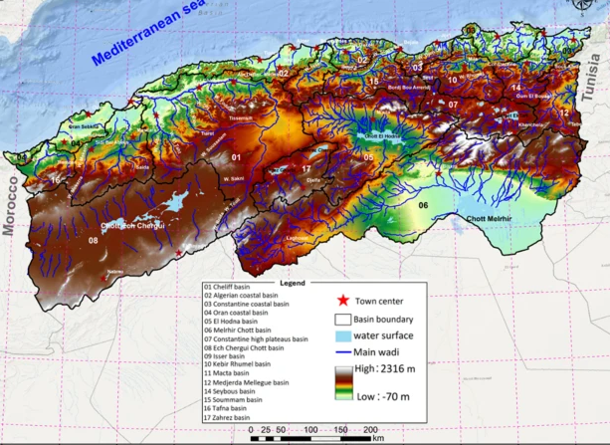
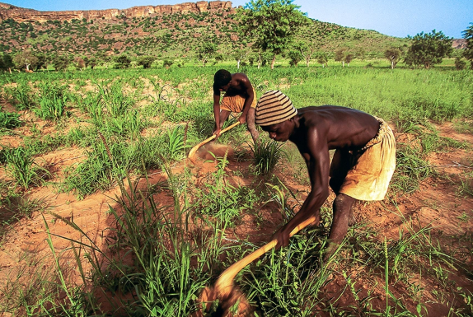
Visit:∞ https://www.nature.com/articles/s41598-025-95418-8
Market Overview
Global smart agriculture > $18B; ~12% CAGR.
Initial target: North Africa, Sub‑Saharan Africa, SE Asia (water scarcity, off‑grid).

Slide 15

Financial Overview
Costs & pricing
Revenue & growth
Initial investment ≈ 1.2M DZD.
Device price band: 30000–35000 DZD + optional SaaS.
Year‑1 revenue: 2–3M DZD; expand to 1000 clients by Year 2.
Focus on affordability, impact measurement, retention.
- Initial Investment: 1,200,000 DZD for hardware, AI model development, and testing
- Revenue Forecast (Year 1): 2,000,000 DZD to 3,000,000 DZD
- Device Price: 30000–35000DZD with optional analytics subscription.
- Projected Growth: Expanding to 1,000 clients in Year 2

Slide 16

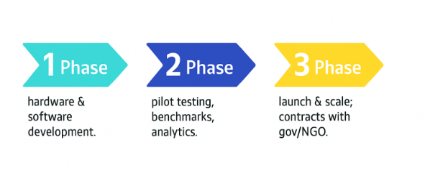
Timeline & Milestones
Phase 1 (M1–M6): hardware & software development.
Phase 2 (M7–M12): pilot testing, benchmarks, analytics.
Phase 3 (Year 2): launch & scale; contracts with gov/NGO.

Slide 17
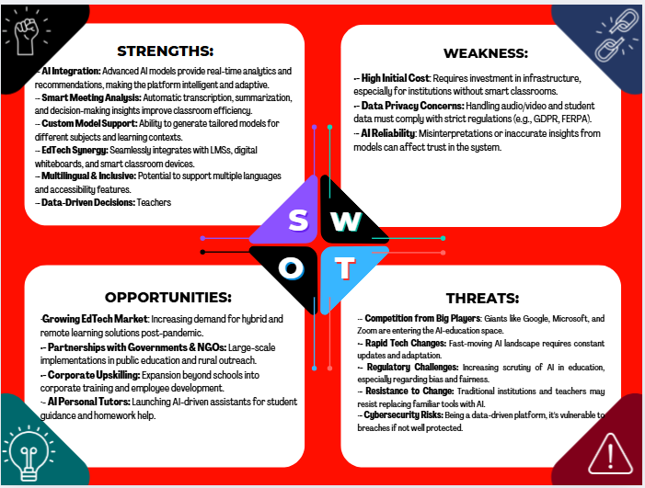
SWOT Analyses
Illustrative device visuals and concept renders.

Slide 18
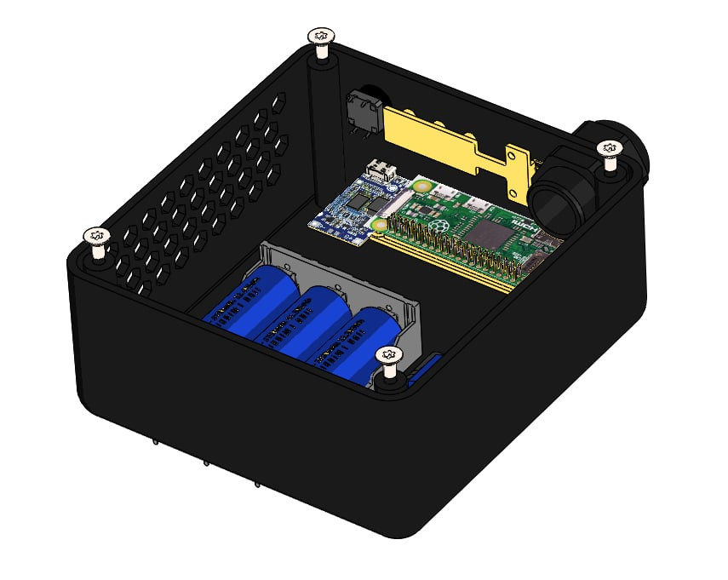
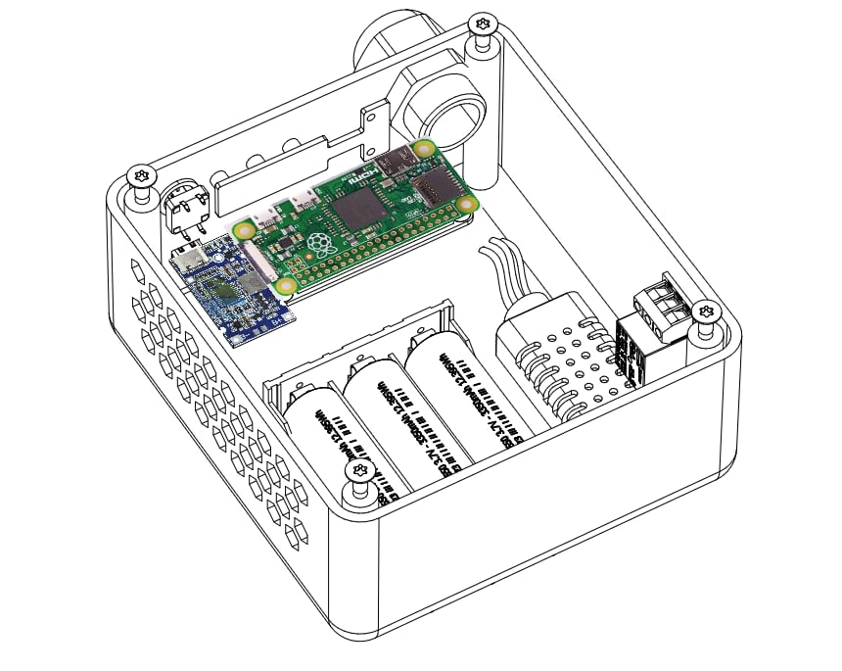
Inside the Box
Electronics
Power & API
Solar‑powered; battery buffered.
Lightweight Flask API for telemetry & commands.
Mobile/cloud monitoring & remote valve control.
AI board (MCU + camera circuitry).
Sensor board with headers (flow, pressure, soil).
Blue terminal blocks; 12‑V solenoid driver.

Slide 19
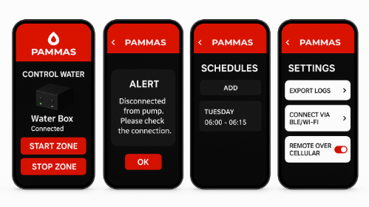

Mobile App — Full Control
Start/stop zones, pump interlocks, schedules.
Alerts & logs; exportable reports for audits.
BLE/Wi‑Fi setup; remote over cellular where available.
FULL REMOTE WIFI ACCESS

Slide 20

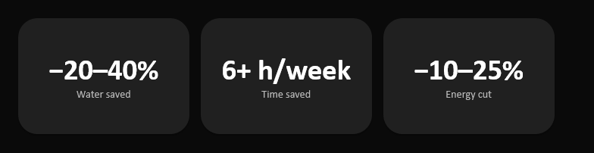
Challenges & Mitigation
Challenges
Mitigation
Hardware scalability
AI accuracy
Distribution logistics
Local manufacturing partners.
Broader datasets + continuous learning.
Co‑ops & agencies for deployment support.

Slide 21



Competitive Landscape
Global
Local / Regional
Netafim — drip + digital solutions
Rain Bird — controllers & systems
SupPlant — AI irrigation optimization
WaterBit — IoT + analytics
Irigreen projects; Farmonaut (sensors)
AgriLink / AgriTech DZ distributors
Residential: Rachio, Orbit

Slide 22
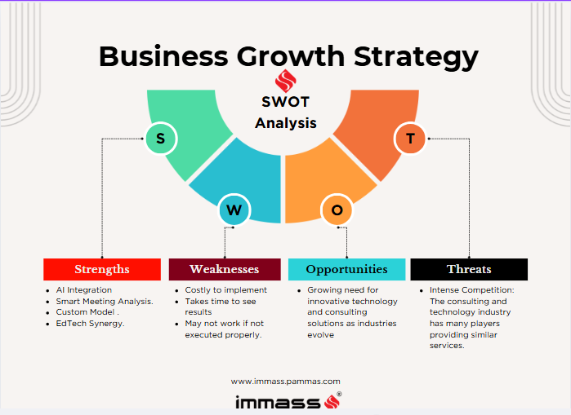
SWOT (summary)
Strengths / Opportunities
Weaknesses / Threats
Offline/solar hardware; hardware+app integration.
Accessible price point; potential to scale globally.
Early prototype; initial setup costs; maintenance needs.
Supply chain risks; traditional alternatives.

Slide 23
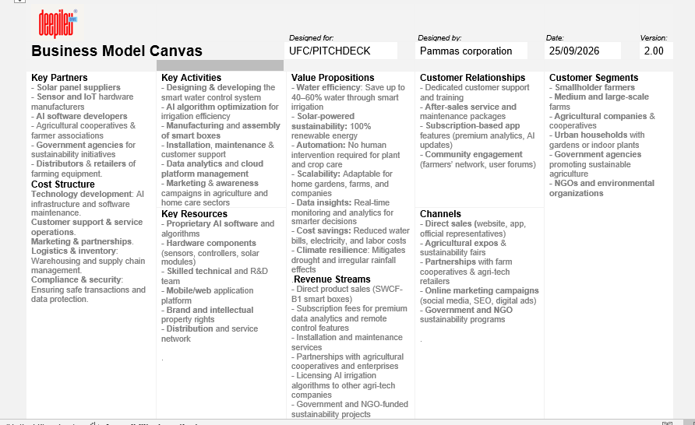
BMC (Full Shema)

Slide 24
What We Need
Technical resources
Funding & supply chain
Hardware engineers (durability, power).
AI/ML devs (models, anomaly detection).
Embedded & backend engineers (firmware, cloud).
Initial 1.2M DZD; Year‑1 revenue 2.5M+ DZD.
Production partners for enclosures, panels, sensors, chips.
Stable suppliers & logistics network.
http://localhost:3000/admin/dashboard
Is seeking reliable equipment providers and technology partners to support the next stage of our smart irrigation and AI-driven system deployment. We require high-quality sensors, control units, and durable electronic components optimized for outdoor agricultural environments. Collaboration with manufacturers of IoT devices, solar-powered systems, and precision hardware will help us enhance product reliability and scalability. Additionally, we aim to partner with cloud service providers and AI infrastructure vendors to ensure secure, real-time data processing and system integration.

Slide 25

Market Access & Partnerships
Pilot projects with farms, co‑ops, NGOs/agencies.
Government/NGO partners for rural deployment, subsidies, data sharing.

Slide 26
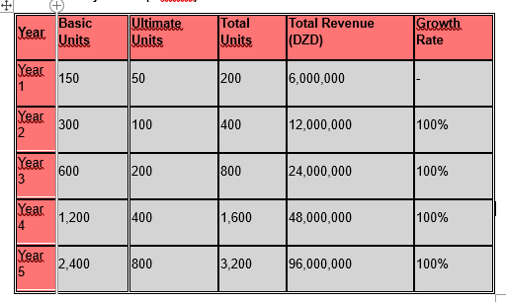
Revenue Model & Projections
Revenue: device unit sales + SaaS analytics + service contracts.
Goal: 1000 customers by Year 2; +15% annual retention via software value.
Revenue sources: Smart device unit sales, SaaS analytics subscription, and service contracts. Growth projection: 1,000 customers by Year 2, with 15% annual retention increase through value-added software updates and partner integrations.

Slide 27
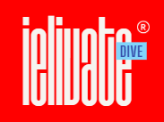

Logos & Brand
ielivate / Pammas Group brand.
Color system: red (#E10600), black, white.
Consistent device labeling & dashboard theming.

Slide 28
Links & Contact
Full report: https://ielivate.com
Demo: https://ielivate/demo
LinkedIn: /company/ielivate | Founder: /in/ibrahim-mohammed-fr/
Email: mail@ielivate.com

